Slide 1

STACK OVERFLOW
DEVELOPER SURVEY 2019
Laïd ATTIA
November 22, 2022

Slide 2

OUTLINE
Executive Summary
Introduction
Methodology
Results
Visualization – Charts
Dashboard
Discussion
Findings & Implications
Conclusion
Appendix

Slide 3

EXECUTIVE SUMMARY
Relevant skills required in the field of IT and business consulting are ever-changing and evolving.
It is important to identify future skill requirements and trends to keep pace with changing technologies and remain competitive.
This presentation will show current and future trends in Programming Languages, Databases, Platforms and WebFrames.
Overall, the aim in identifying future skill requirements and trends is to help the firm make more informed data- driven hiring and budgetary decisions.

Slide 4

INTRODUCTION
This presentation has been created for stakeholders
and business decision makers within the global IT and business
consulting services firm.
The presentation will help identify future skill requirements in the global IT sector necessary for the firm to keep pace with changing technologies and remain competitive.
Recommendations will be stated based on the analysis.

Slide 5

METHODOLOGY
Using a modified subset of the Stack Overflow dataset¹, the data was wrangled in order to remove duplicates, impute missing values and normalize data.
Next, the data underwent exploratory analysis in order to find the distribution of data, presence of outliers and determine the correlation between different columns in the dataset.
The data was then used to visualize the distribution, the relationship between two features and the composition and comparison of data.
Finally, after downloading two files², which are also a modified subset of the Stack Overflow dataset, Cognos Dashboard Embedded (CDE) was used to create the “Current Technology Usage”, “Future Technology Trends” and “Demographics” slides.
Appendix
To obtain average annual salaries web scraping was used to extract information from a website then saved to a csv file.

Slide 6

RESULTS

Slide 7
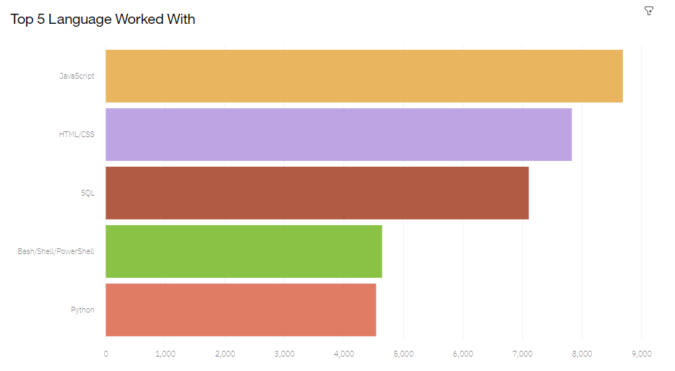
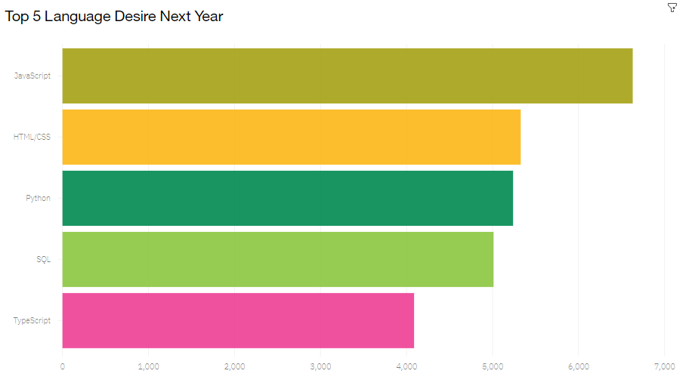
PROGRAMMING LANGUAGE TRENDS
Current Year Next Year

Slide 8
PROGRAMMING LANGUAGE TRENDS - FINDINGS & IMPLICATIONS
Implications
Continue to employ a similar number of people skilled in JavaScript and HTML/CSS.
1
JavaScript and HTML/CSS continue to be the top two most popular programming languages for this year and next.
Python and TypeScript have gained more interest for next year.
Whereas interest in
SQL and Bash/Shell/PowerShell has decreased.
Findings
Employ more people skilled in Python and TypeScript.
2
3
Employ less people skilled in SQL and Bash/Shell/PowerShell.

Slide 9
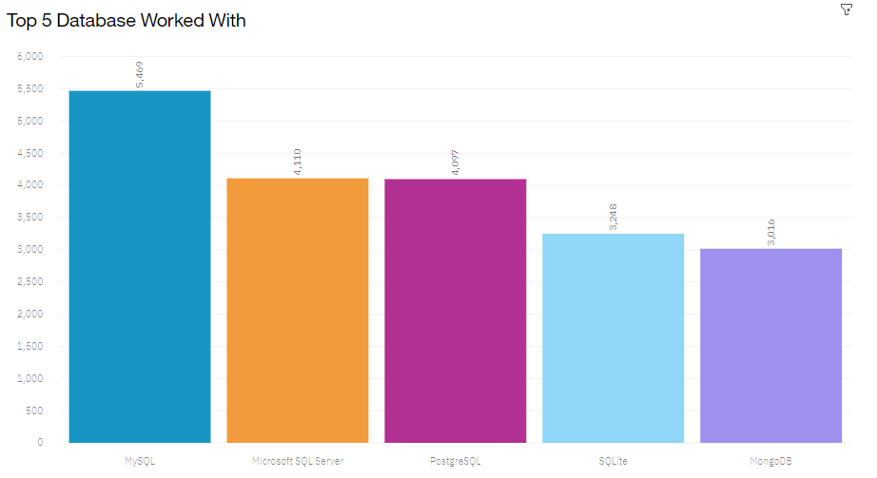
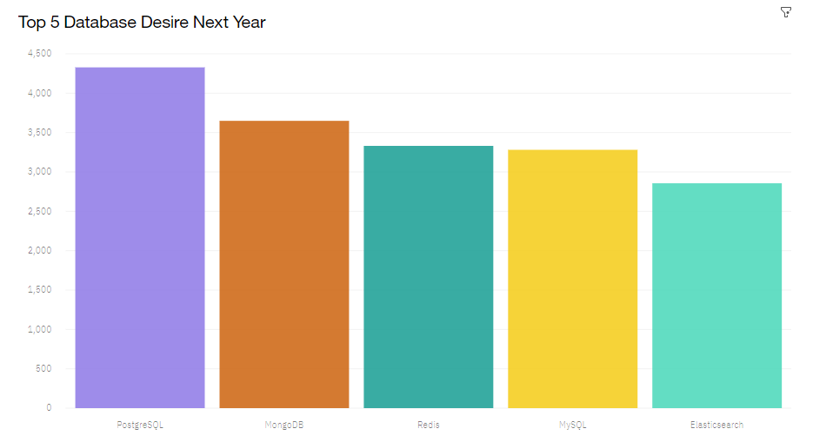
DATABASE TRENDS
Current Year
Next Year

Slide 10
DATABASE TRENDS - FINDINGS & IMPLICATIONS
Implications
Employ less people skilled in
MySQL, Microsoft SQL Server and SQLite.
1
Interest in MySQL, Microsoft SQL Server and SQLite has decreased for next year.
Findings
Interest in PostgreSQL and MongoDB have increased compared to the current year.
There is gained interest in Redis and Elasticsearch for next year.
Employ more people skilled in
PostgreSQL and MongoDB.
2
3
Employ more people skilled in Redis and Elasticsearch.

Slide 11

DASHBOARD
Click here to view the Cognos dashboard

Slide 12
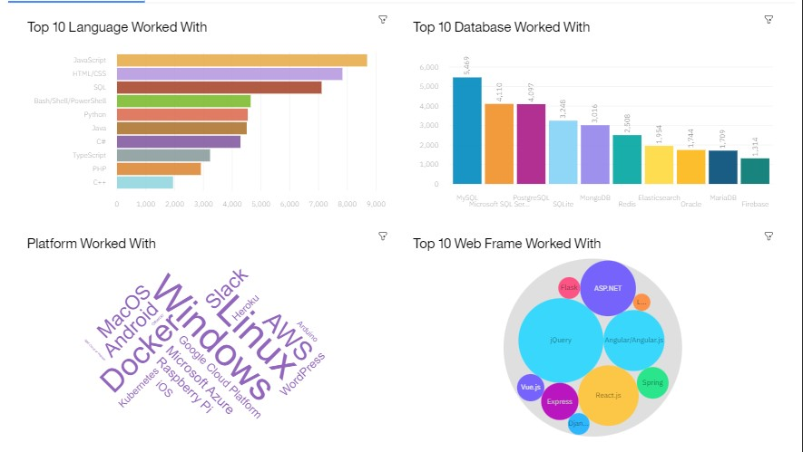
DASHBOARD TAB 1

Slide 13
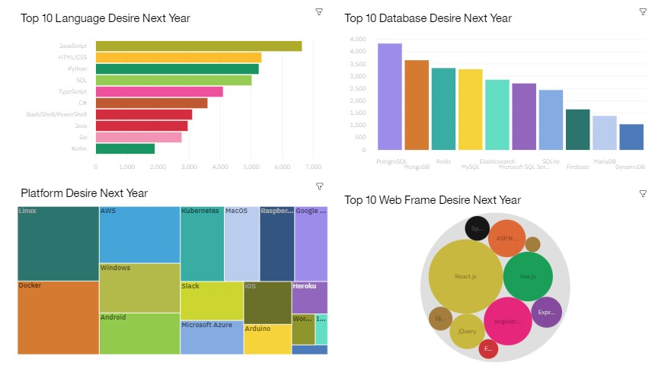
DASHBOARD TAB 2

Slide 14
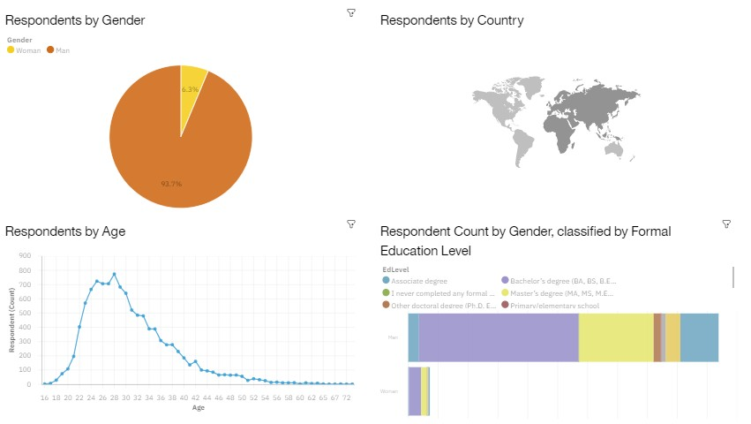
DASHBOARD TAB 3

Slide 15
DISCUSSION

Slide 16
OVERALL FINDINGS & IMPLICATIONS
Implications
Continue to staff enough JavaScript and HTML/CSS but employ
more people skilled in TypeScript and Python.
1
Programming Languages - TypeScript
is gaining significant interest
and Python continues to grow as well.
Databases - Redis, Elasticsearch, PostgreSQL and MongoDB are gaining more interest.
Platforms - Interest Slack and Windows is dropping significantly.
WebFrames - Vue.js is gaining substantial interest and React.js continues to grow as well.
2
Employ more people skilled in Redis, Elasticsearch, PostgreSQL
and MongoDB.
Findings
3
Continue to staff enough ASP.NET but employ more people skilled in Vue.js and React.js.
4
Continue to staff enough Linux, employ more peopleskilled in Docker, AWS and Android, but make reductions to Slack and Windows.

Slide 17

CONCLUSION
1 | Carve out budget in order to hire additional staff with skills needed to fill any gaps.
2 | Set aside budget or put a program in place to upskill those already employed.
3 | Make adjustments in staff for those skills no longer in demand.

Slide 18

APPENDIX

Slide 19

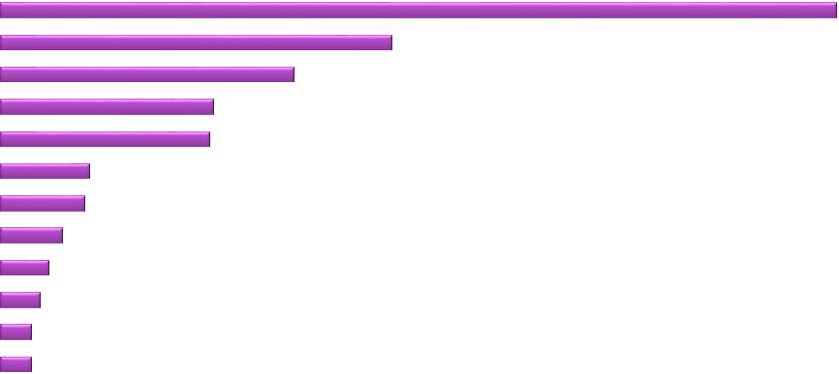




GITHUB JOB POSTINGS
C
Java |  |  |  |  |  | 88
JavaScript |  |  |  |  | 66
Python |  |  |  | 48
Scala |  |  |  | 47
C# |  | 20
C++ |  | 19
SQL Server | 14
PostgreSQL | 11
Oracle | 9
188
LANGUAGE
MongoDB
MySQL Server
7
7
0
20
40
60
80
100
NUMBER OF JOB POSTINGS
120
140
160
180
200

Slide 20

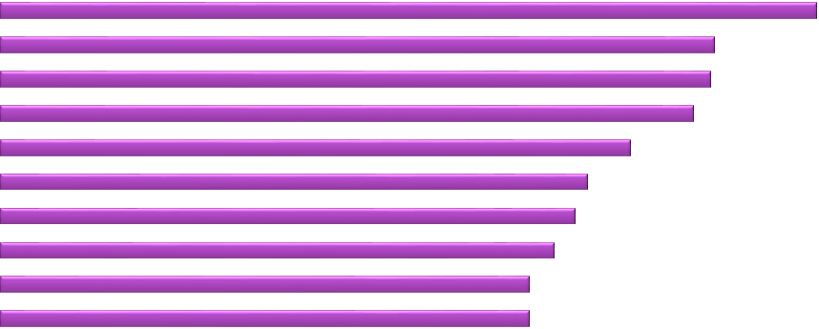
POPULAR LANGUAGES
Swift
$130,801
Python
$114,383
C++
$113,865
Javascript
$110,981
In Module 1 you have collected the job postings data using web scraping in a file named
“popular-languages.csv”. Present that data using a bar chart here. Order the bar chart in
the descending order of salary.
LANGUAGE
Java
$101,013
Go
$94,082
R
$92,037
C# SQL
$88,726
$84,793
PHP
$84,727
$60,000 $80,000
AVERAGE ANNUAL SALARY
$0
$20,000
$40,000
$100,000
$120,000
$140,000

Slide 21
RESOURCE
https://stackoverflow.blog/2019/04/09/the-2019-stack-overflow-developer-survey-results-are-in/
m5_survey_data_demographics.csv and m5_survey_data_technologies_normalised.csv
https://jobs.github.com/api
github-job-postings.xlsx
https://cf-courses-data.s3.us.cloud-object-storage.appdomain.cloud/IBM-DA0321EN- SkillsNetwork/labs/datasets/Programming_Languages.html

Slide 22
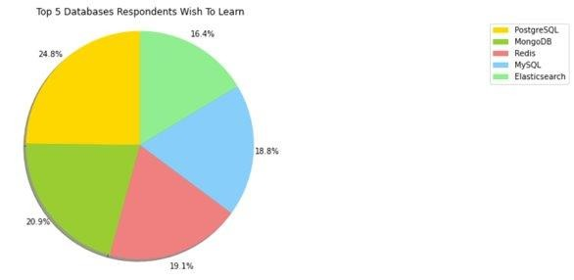
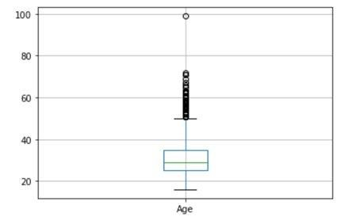
ADDITIONAL VISUALS
Box Plot of Age of Survey Respondents

